Slide 1
Read & Write csv FILE
By: Jediniah Womack
Saiquan Jamison

Slide 2
What is a CSV
(CSV)Comma separated value file- It is a plain text file that uses specific structuring to arrange tabular data.

Slide 3
What is data wrangling
Data wrangling, sometimes referred to as data munging, is the process of transforming and mapping data from one "raw" data form into another format such as analytics.

Slide 4
Where do Csv files come from
It comes from programs that handle large parts of data, convenient way to export data from spreadsheets and databases as well as import and use it in other programs.
The CSV library provides functionality both to read from and write to CSV files.

Slide 5
How to read & write in csv
Import pandas as pd
Df = pd.read_csv(“stack_data.csv”)
Df.to_csv(“stack_data.csv”)
Notes:
Reading from a CSV file is done using the reader object. The CSV file is opened as a text files with Python’s built-in open () function, which returns a file object.

Slide 6
How to use headers in csv
Df = pd.read_csv(“stack_data.csv”, skiprows = 1)
Df = pd.read_csv(“stack_data.csv”, header = 1)
Df = pd.read_csv(“stack_data.csv”, header = none

Slide 7
skiprow while reading csv file
Skiprow- Line numbers used to skip rows while reading csv.
If it’s an int then skip that lines from top
If it’s a list of int then skip lines at those index positions
If it’s a callable function then pass each index to this function to check if line to skipped or not.

Slide 8
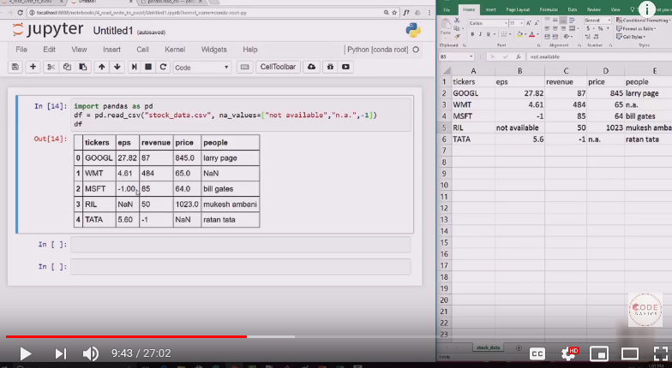
Using ‘not available’

